Slide 1

The HOMELESS: Austin VS. San Francisco.
Elijah Montgomery
Jason Casperson
Julian Pecino

Slide 2




MEET OUR TEAM
Elijah Montgomery
Jason Casperson
Presidente
Chief Executive Officer
Julian Pecino
Chief Operations Officer

Slide 3

Agenda
Introduction
Building Policies
Cost of Living Comparison
Rate of Homelessness
Findings of Comparisons
Summary

Slide 4

INTRODUCTION
The issue of being, or becoming homeless has always existed since ancient times. Today we are going to take a look at these same issues with a modern lens and see what are some of the factors that can drive someone to the point of losing their home. Join us as we explore what can be the cause.

Slide 5

Building & Zoning Policies
San Francisco and Austin

Slide 6
Zoning policies
 | Types of Reform | Flexibility | Affordability | Types of Zone
San Fran | A notable example is the 2018 "Affordable Housing Bonus Program," | 2.3 | 1.7 | 5
San Fran | This was met with significant community opposition. | 5.1 | 4.4 | 3
Austin | CodeNEXT, aimed at revising the land development code to encourage more housing types and use of public transit. = | 1.7 | 2.5 | 2.8
Austin | These efforts have faced considerable pushback. | 2.2 | 1.7 | 7

Slide 7
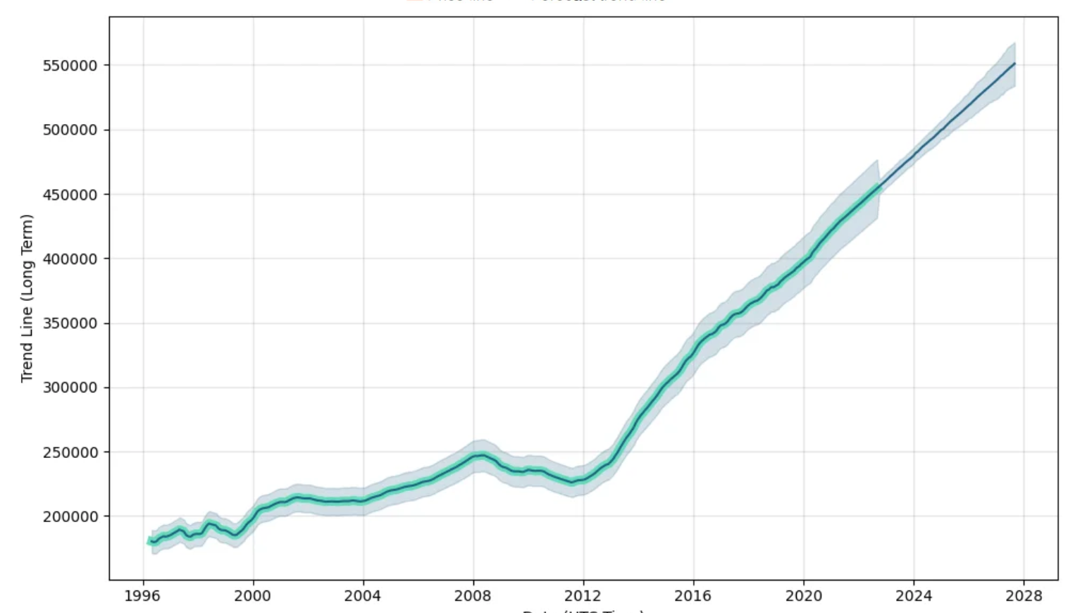
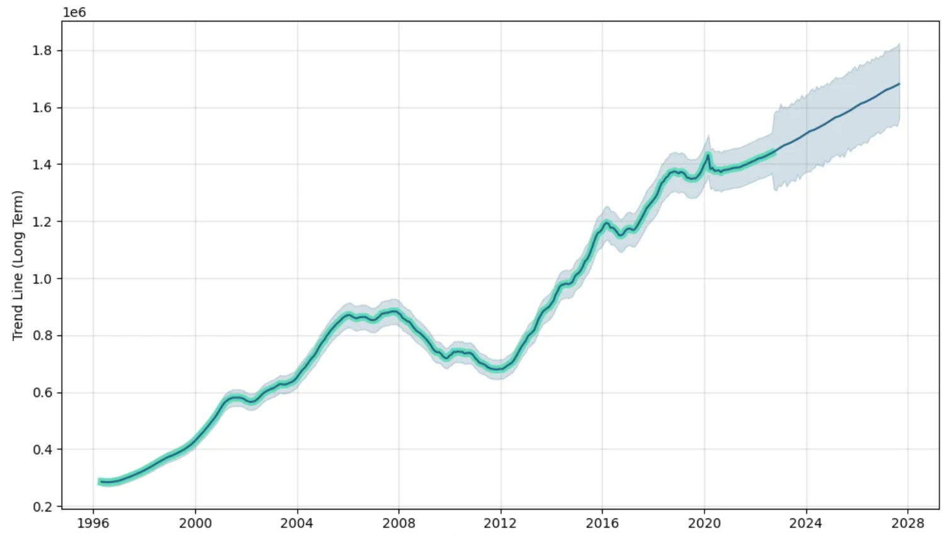
Housing index Austin Vs. San Fran
Date (UTC Time)
Date (UTC Time)

Slide 8

AREAS OF FOCUS
Develop winning strategies to keep ahead of the competition
Capitalize on low hanging fruit to identify a ballpark value
Visualize customer directed convergence

Slide 9
HOW WE GET THERE
Services
Be sure to look for any services provided to the public by the government for any assistance necessary .
Vote at your local legislative location for positive changes in policies and regulations.
location
Be sure to check and really figure out where you are in the city. It may be somewhere that is critical to survival.
Engage local authorities or churches to ask for help or assistance.
COMPASSION
Cultivate one-to-one empathy with another person's plight. Putting yourself in their shoes may shed some light and help remind you to be a better person that day.

Slide 10

SUMMARY
Navigating the Vague Path Forward
As we navigate the shadows of homelessness in Austin and San Francisco, we must acknowledge the complexity of this issue and the vague, uncertain paths that lie ahead. The homeless issue is not a monolith but a collection of stories, struggles, and aspirations. It is only through a deeper understanding of these complexities that we can hope to create a more compassionate and inclusive society where homelessness becomes a vague memory of the past.

Slide 11
THANK YOU
References:
- HOMELESS IN TEXAS
A Rising Tide Drowns Unstable Boats: How Inequality Creates Homelessness

